Slide 1
Work Breakdown Structure

Slide 2
SW
Project
SCOPE
Deployment
Planning
UAT
Operation
Requirements
Maintenance
Design
Development
Testing
Built
Release

Slide 3
Project Management
Planning
Estimating
Scheduling
Define activities & deliverables
Time, Cost in terms of resource usage
Define sequence of tasks occurrence

Slide 4
Why is it needed?
Create WBS
Estimation techniques
Identify dependencies
For task identification
Using graph/network diagram
Create Tasks Schedule
Gantt. Chart
W.r.t size & efforts (i.e. Software productivity)
Reduced chances of project failure
Fails because of incomplete tasks’ quotation

Slide 5
What is WBS?
a work breakdown structure is:
“A hierarchical decomposition
of the total scope of work
to be carried out by the project team
to accomplish the project objectives
and create the required deliverables.”

Slide 6
WBS
Dividing complex projects to simpler and manageable tasks.
Stops till the tasks no longer remains decomposable.
Work packages are the smallest unit of work that a project can be broken down into when creating your Work Breakdown Structure (WBS).
A WBS element may be a product, data, a service, or any combination.
6

Slide 7
WBS
The WBS is a deliverable-oriented hierarchy / activity-oriented hierachy of decomposed project components.
Articulates the detailed project scope statement that specifies the work to be accomplished by the project.
WBS

Slide 8
When should we develop WBS?
Once the project Scope is decided then its needed to plan various components (activities/deliverables) of software development project.

Slide 9
How to create WBS?
Done by project mangers mostly
Determine and describe the project statement
Highlight all necessary phases in the project
Sometimes the scope is divided to different phases depending upon project
Lowest level not too detailed, not too large
Create deliverables
Check for completeness - is all the effort included?
Assign deliverables to each team
9

Slide 10
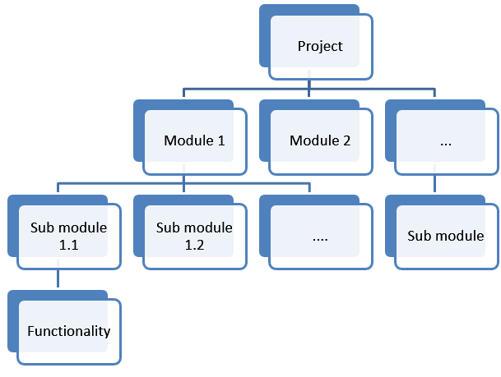
WBS

Slide 11
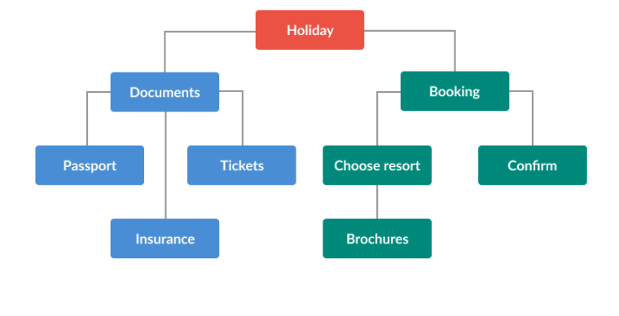
WBS
WBS

Slide 12
Reasons to use WBS
It helps with the correct project organization.
It depicts whole project work needed for org.
It assists in describing the project scope to stakeholders.
It helps to distribute responsibilities.
Visualize each member’s activity & role in project.
It shows the project milestones and all the points to control.
Helpful in cost estimation, resource allocation, and time management improvements.
Minimize unnecessary work which leads to missed deadlines & scope creep issues

Slide 13
Steps to build a WBS
Begin with the Charter, focusing on Objectives and Deliverables
Break the main product(s) down into sub-products
Set the structure to match how you’ll manage the project
Lowest level not too detailed, not too large
Identify support activities
Check for completeness - is all the effort included?
Assign work package to managers
13

Slide 14
Levels in WBS
Starts with level 0 i.e. project title
Then make level 1, highest level breakdown of about 4-7 nodes depending on your project. Termed as control accounts
Then make level 2 are work packages.
Level 3 are the tasks/activities to be performed
Follow the standard numbering scheme
14

Slide 15
WBS levels
Library management Systems
Database
Front end application
Servers configuration
data structures used
Database creation
UI design
……
ER diagram

Slide 16
WBS Formats
2 Formats
Outline (Indented Format)
Graphical Tree (Organizational Chart)

Slide 17
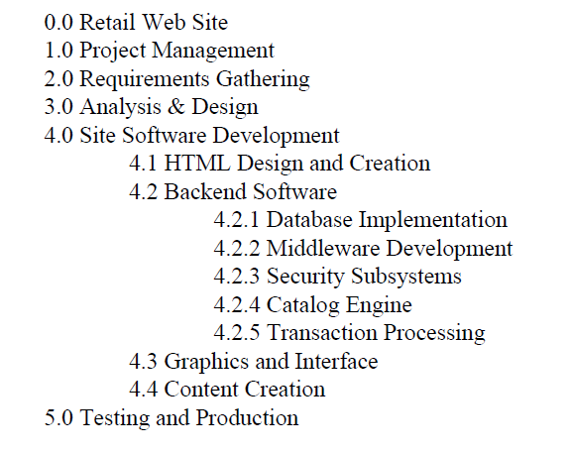
Displaying the WBS Example of outlined WBS.
17

Slide 18
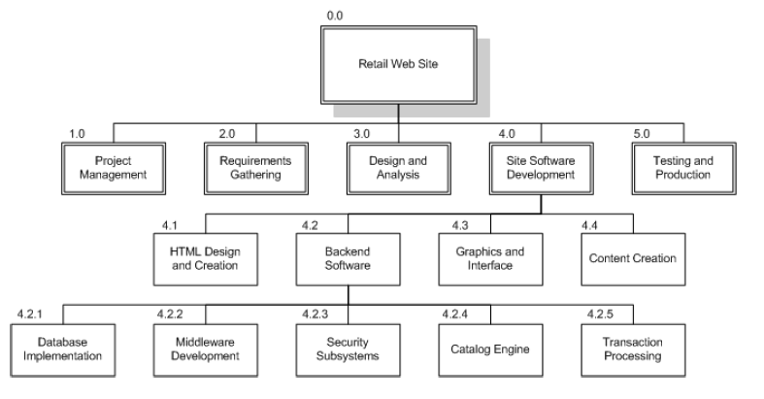
Displaying the WBS Example of Graphical Tree WBS
18

Slide 19
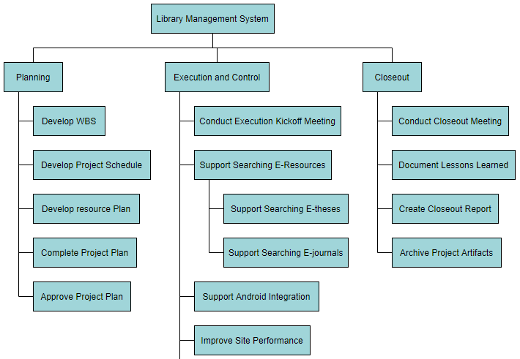
https://online.visual-paradigm.com/diagrams/features/work-breakdown-structure-software/

Slide 20
Challaenges
Must have concrete knowledge of project
All tasks/ deliverables properly identified and quoted
Each task should be broken down into legit activities
20

Slide 21
The Dictionary of the WBS
A WBS dictionary is a companion document to the WBS that describes each WBS element. For each WBS element, the WBS dictionary includes a statement of work, a list of associated activities, and a list of milestones.
Other information can include the responsible organisation, start and end dates, resources required.
WBS

Slide 22
WBS Guidelines
Must be easy to understand
Ensure each element corresponds to a deliverable
Breakdown until you get accurate time and cost estimates
Covers all objectives
22

Slide 23
WBS Guidelines
Should not be much detailed as project plan
May use a template if you have
Can evolve over time
Can be drawn using Gantt Pro, Word, Excel, MS Project, Visio etc.
Each level have no more than 7 items
23

Slide 24
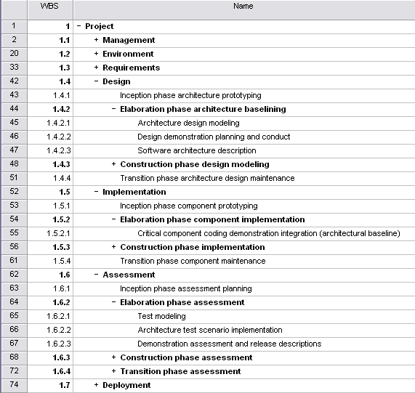
WBS Template
Component groups with a ‘+’ in front of them are ‘rolled up’ – subcomponents are hiden to reduce clutter
24

Slide 25
WBS Check List
Does it define 100% of the work that will be produced by the project?
Does it use a coding structure so that each element has a unique ID that shows its place in the hierarchy e.g. 1.1, 1.2, 1.1.1, 1.1.2?
Will project stakeholders be able to understand the project scope from the WBS?
Does each level represent 100% of the work required to deliver the parent level?
Is the decomposition sufficient that the tasks required to deliver each work package can easily be identified?
Is it in the format that gives a clear graphical, textual or tabular breakdown of the project scope?
25

Slide 26
WBS Check List
Does it have a least two levels with at least one level of decomposition?
Was it created by those who will be performing the work?
Is it being regularly updated as project changes are approved?
Can you identify one person who is accountable for each work package?
Can you clearly define the acceptance criteria for each work package?
Does it allow you to estimate costs accurately?
Does the WBS have logical summary elements that can be used in tracking progress and performance?
26

Slide 27
Example WBS
Redecorate Room
Prepare materials
Buy paint
Buy a ladder
Buy brushes/rollers
Buy wallpaper remover
Prepare room
Remove old wallpaper
Remove detachable decorations
Cover floor with old newspapers
Cover electrical outlets/switches with tape
Cover furniture with sheets
Paint the room
Clean up the room
Dispose or store left over paint
Clean brushes/rollers
Dispose of old newspapers
Remove covers
WBS

Slide 28
Professional Tools used
https://www.projectmanager.com/
https://www.atlassian.com/software/jira
https://ganttpro.com/

